Slide 1
Introduction to Descriptive Statistics

Slide 2
Learning Objectives
By the end of this session, you will be able to:
Understand measures of descriptive statistics: Mean, Median, Mode, Standard Deviation, etc.
Learn how to derive and interpret these measures.
Use Python for hands-on calculation of statistics.

Slide 3
Multiple Choice Questions (MCQs)
What is the primary goal of descriptive statistics?
To make inferences about a population
B) To describe and summarize data
C) To test hypotheses
D) To establish causality

Slide 4
Multiple Choice Questions (MCQs)
What is the primary goal of descriptive statistics?
To make inferences about a population
To describe and summarize data
To test hypotheses
To establish causality
Answer: B) To describe and summarize data
Descriptive statistics aims to provide a summary of the main features of a dataset, making it easier to understand.

Slide 5
What is Descriptive Statistics?
Descriptive statistics summarize and describe the basic features of a dataset.
Purpose:
Simplifies complex datasets.
Identifies patterns, trends, and outliers.
Forms the foundation for more advanced statistical modeling.

Slide 6
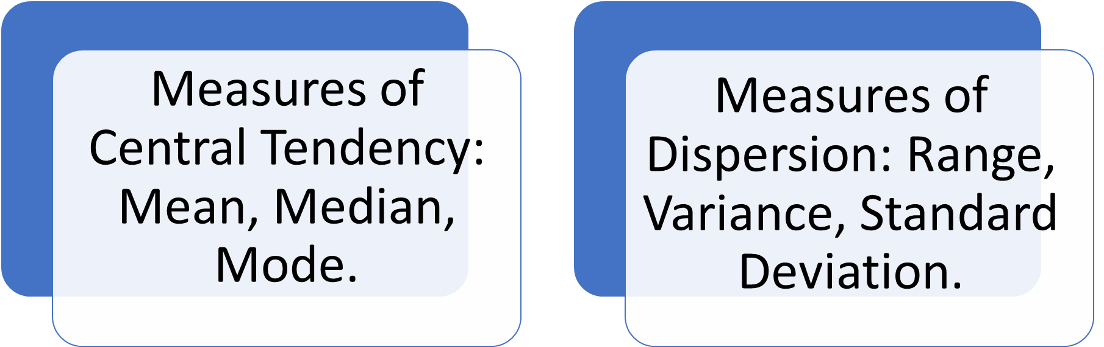
Types of Descriptive Statistics

Slide 7
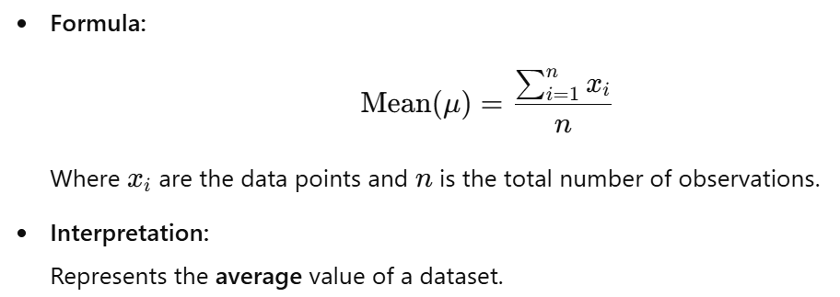
Mean

Slide 8
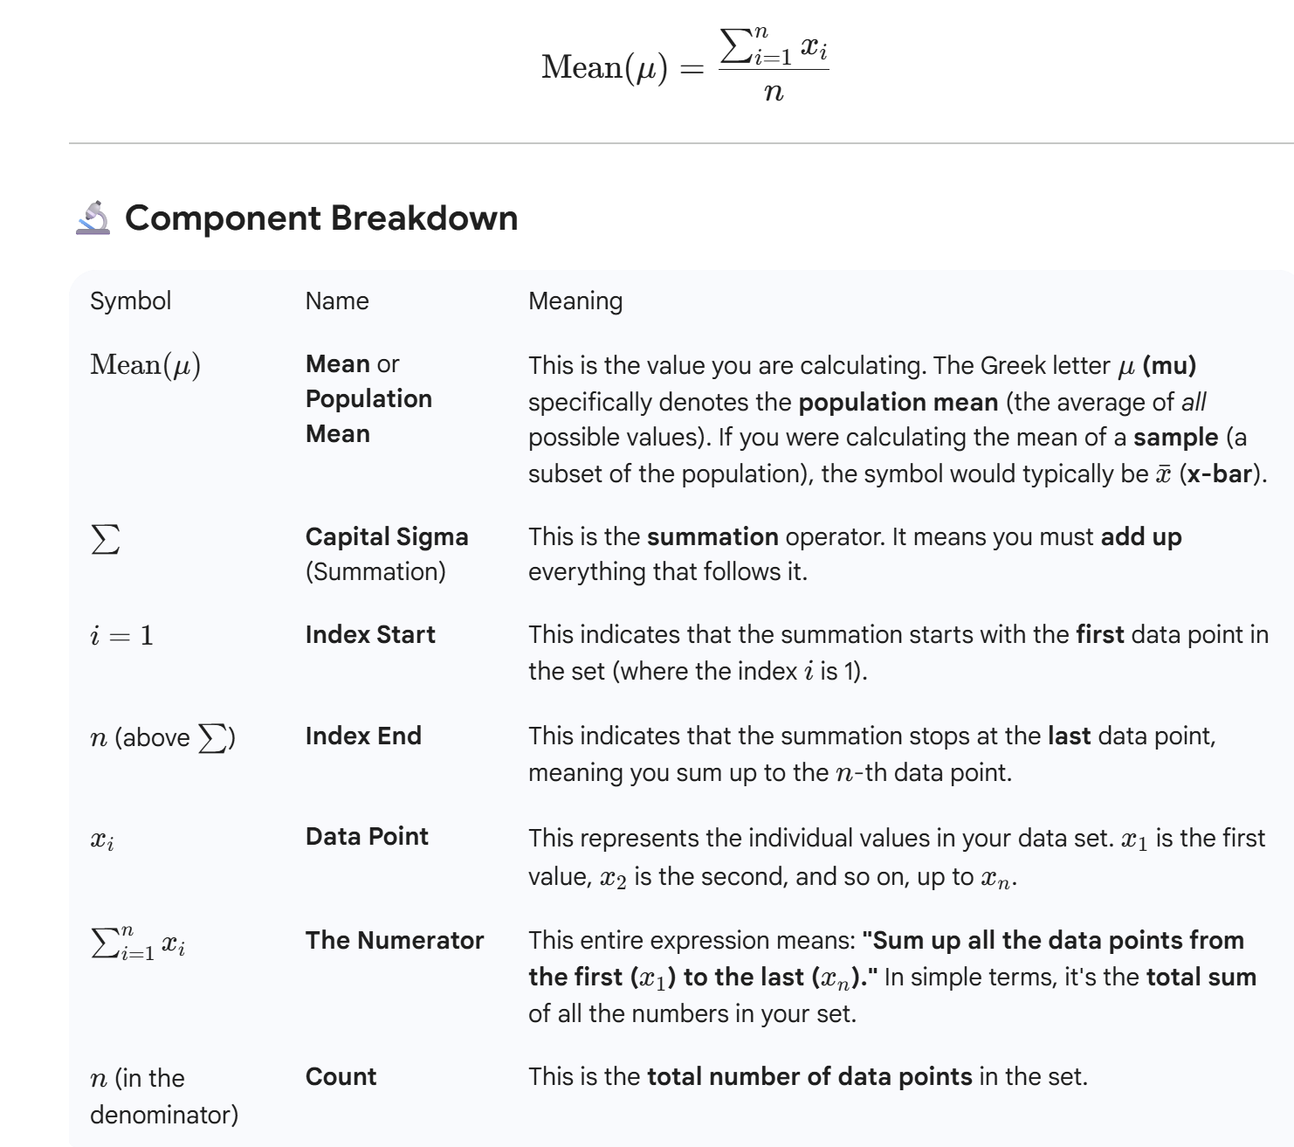

Slide 9
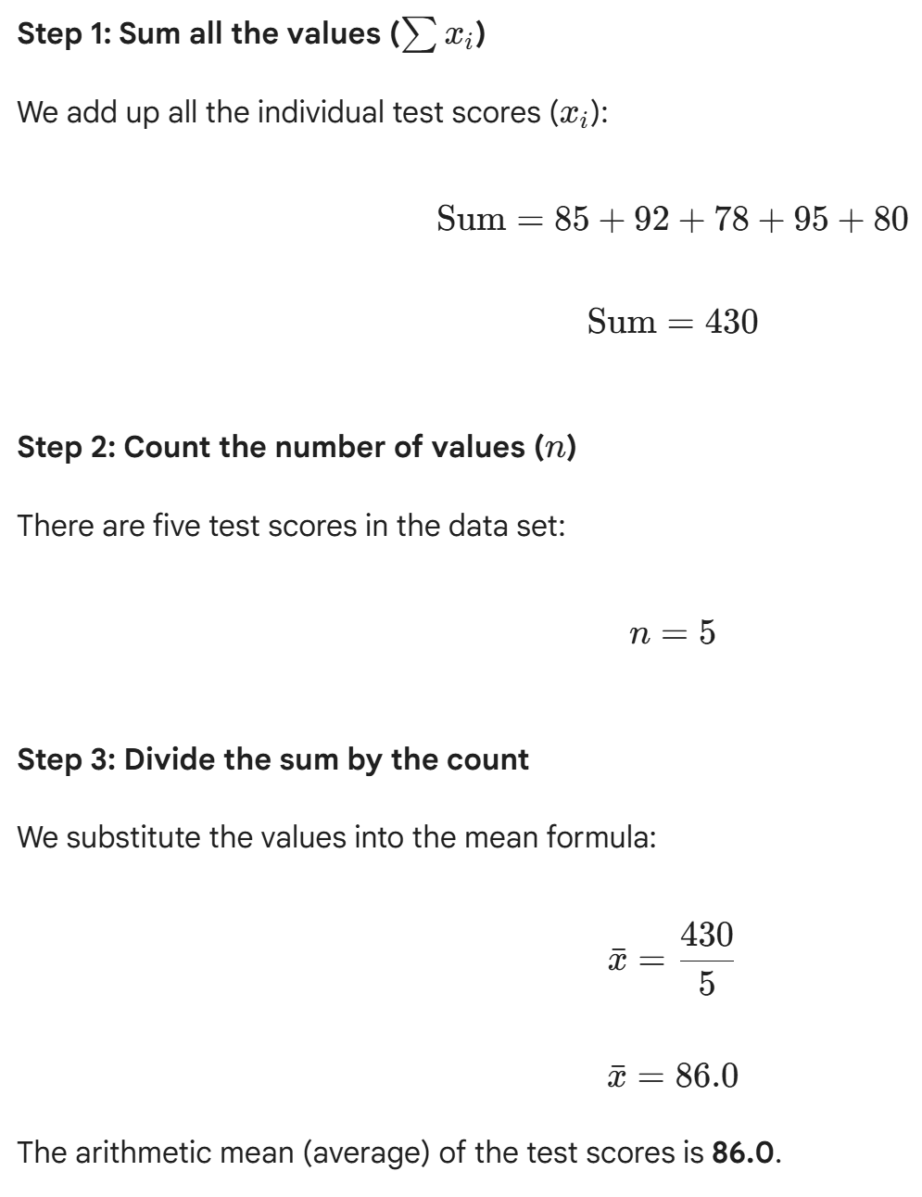
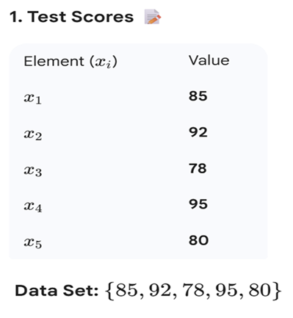

Slide 10
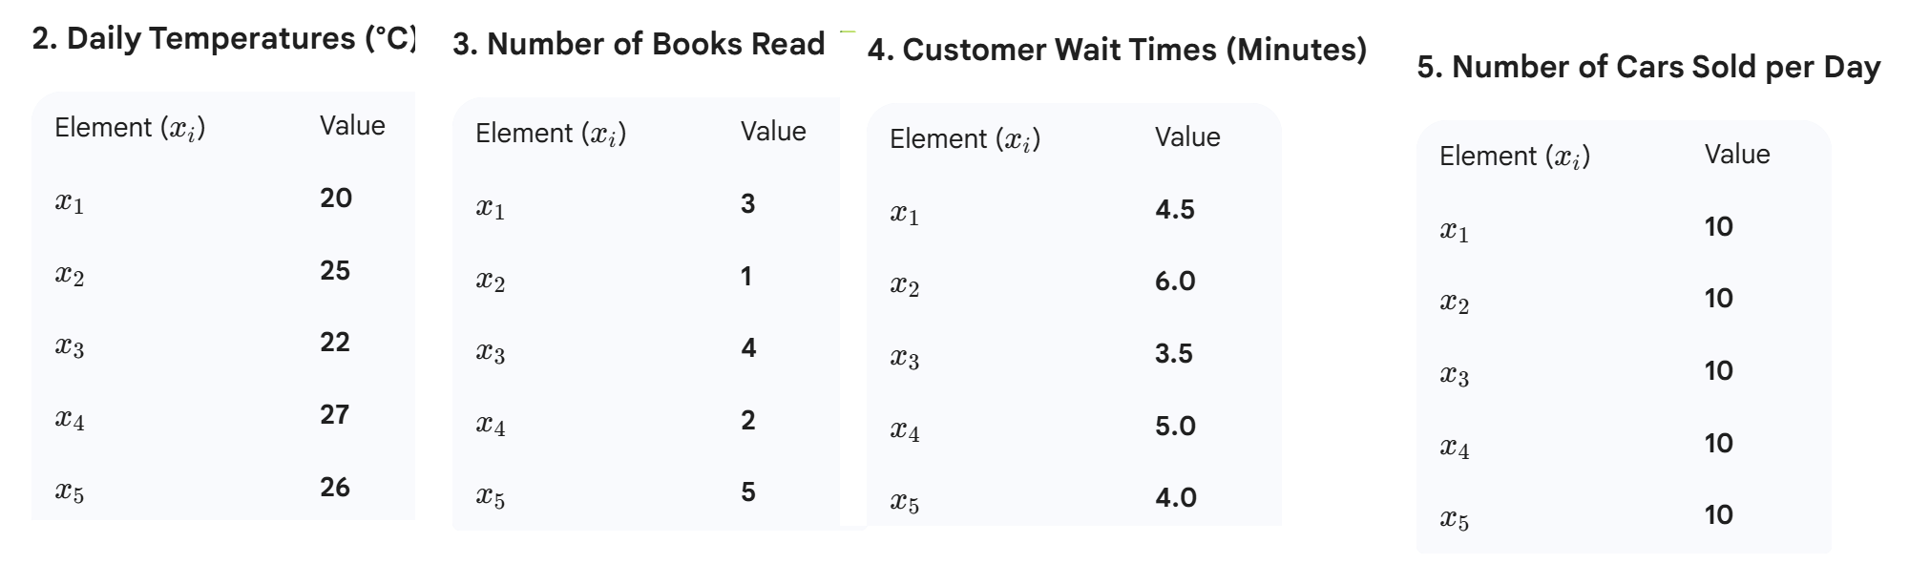

Slide 11
Median
Definition: The middle value when data is sorted in ascending order.
When to Use: Best for skewed data or when there are outliers.
Example:
For data [5, 10, 15, 20, 100], the median is 15, while the mean is skewed by 100.

Slide 12
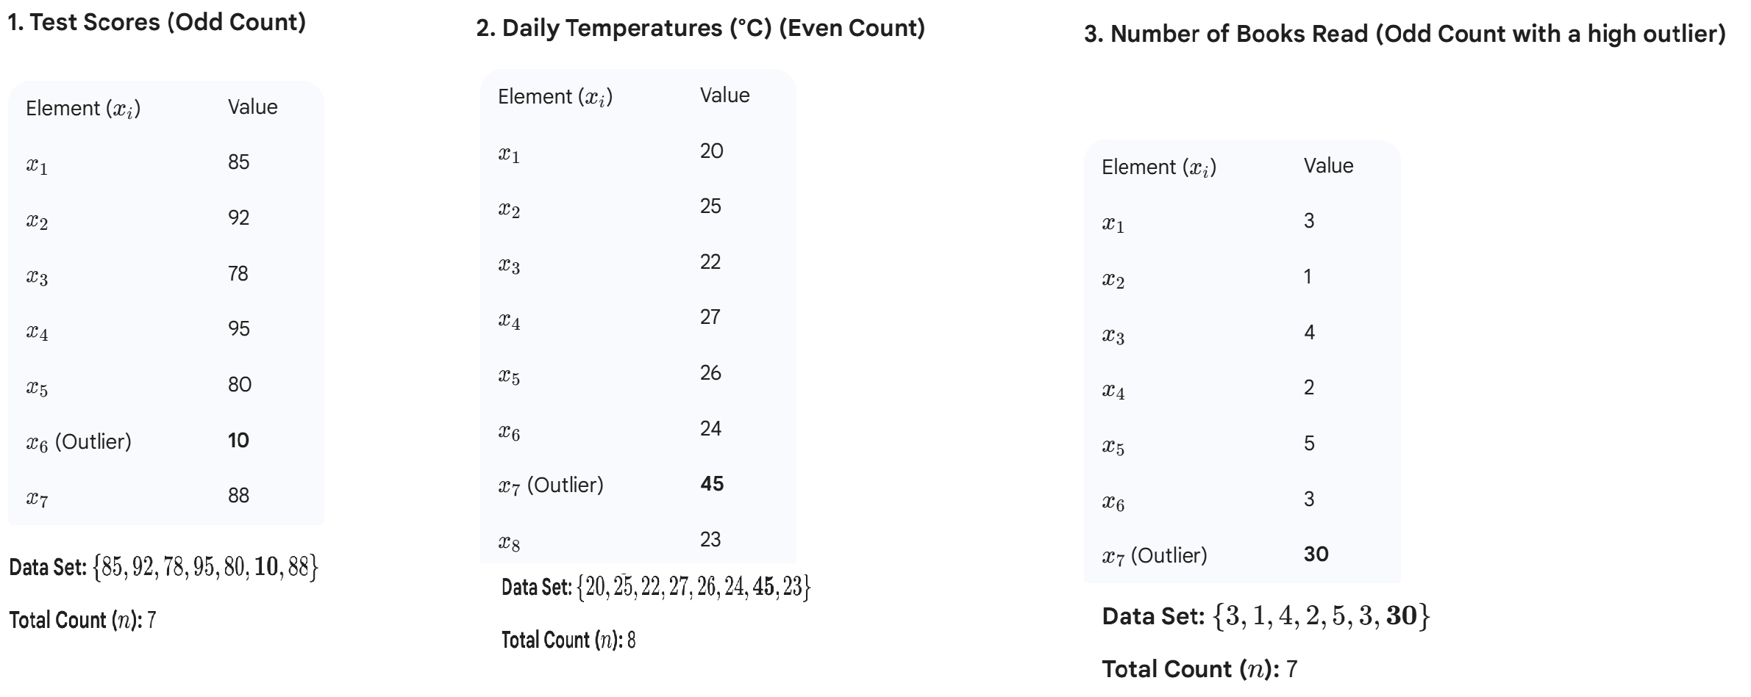

Slide 13
Mode
Definition: The value that appears most frequently in a dataset.
When to Use: Useful for categorical data or identifying the most common occurrence.
Example:
If the most common loan amount is $10,000, that’s the mode.

Slide 14
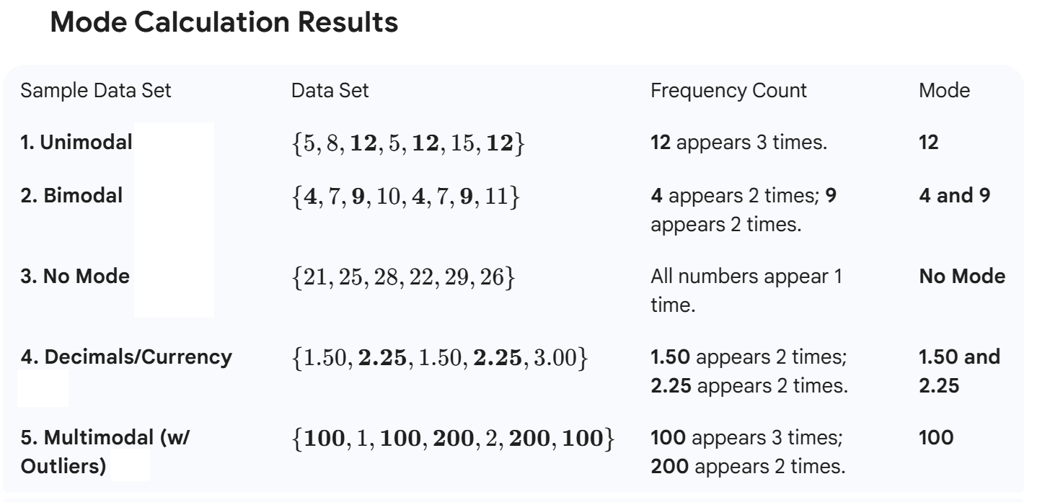

Slide 15
Standard Deviation
Standard deviation is a statistical measure of data dispersion that quantifies how much individual data points differ from the mean (average) of a dataset.
A low standard deviation signifies that data points are clustered closely around the mean, indicating consistency, while a high standard deviation shows that the data points are spread out over a wider range, indicating greater variability.
It is calculated as the square root of the variance, which is the average of the squared differences from the mean.

Slide 16
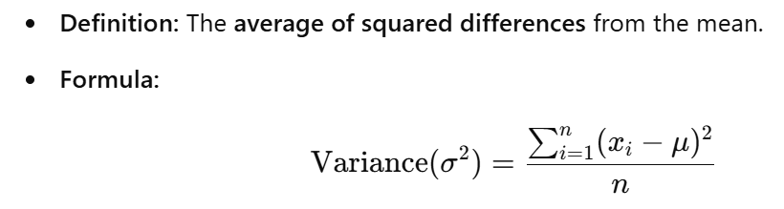
Variance

Slide 17
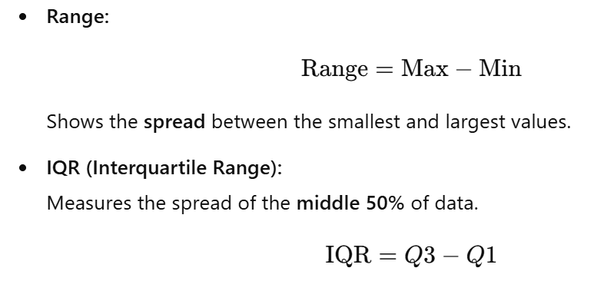
Range and Interquartile Range (IQR)

Slide 18
Range,
IQR (Interquartile Range ),
Variance, and
Standard Deviation (SD)
are the four main ways to measure dispersion (or spread) in a data set.

Slide 19
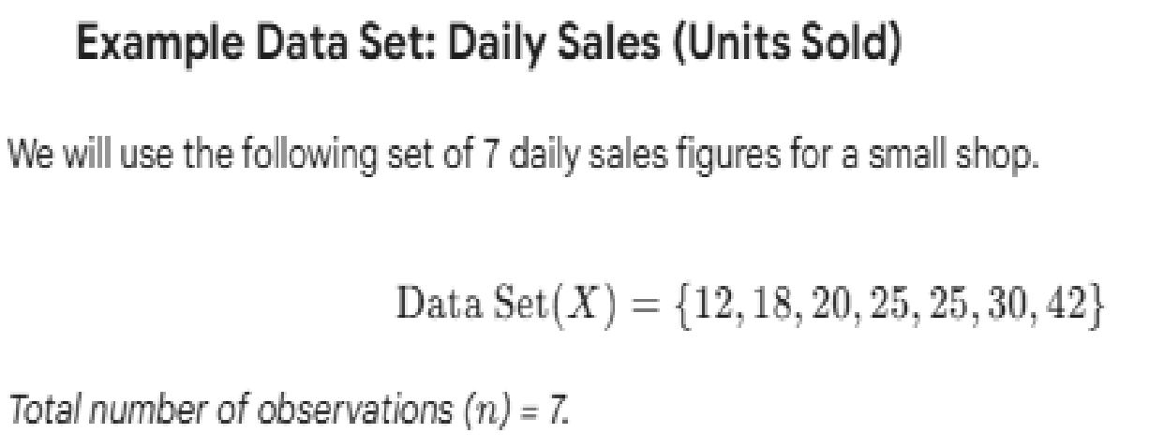
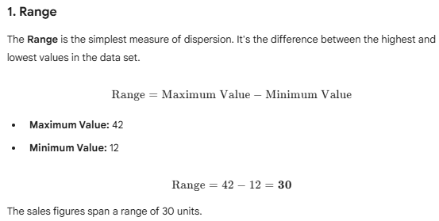

Slide 20
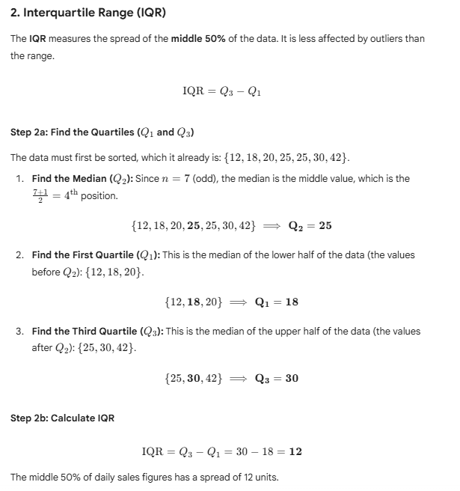

Slide 21
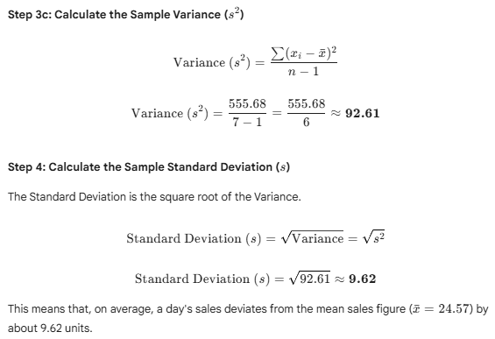
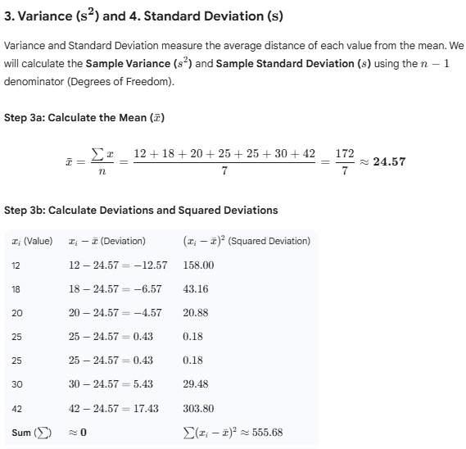

Slide 22
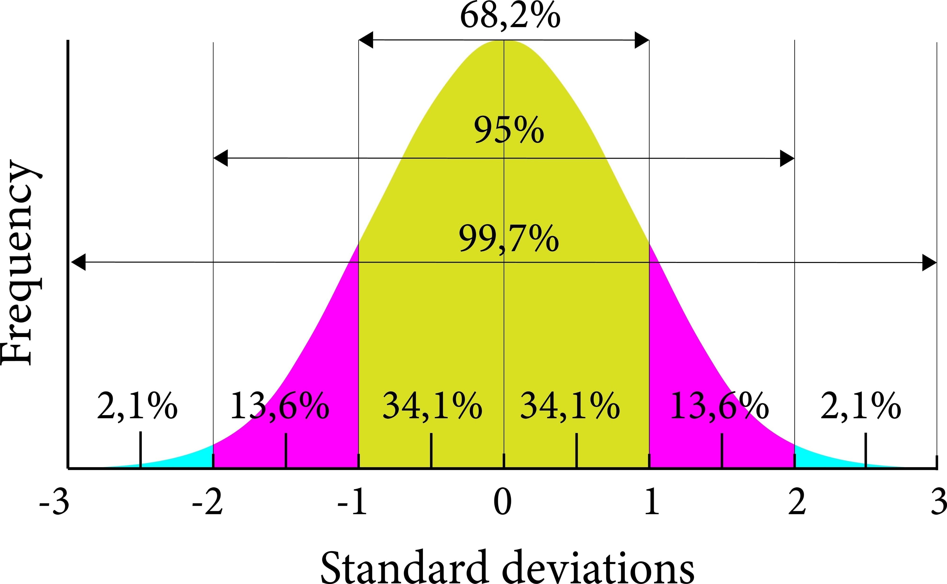

Slide 23
Measure of Dispersion | Result | Interpretation
Range | 30 | The entire data set spans 30 units (from 12 to 42).
IQR | 12 | The middle 50% of sales are spread over 12 units.
Variance ($s^2$) | 92.61 | The average of the squared differences from the mean (units squared, harder to interpret directly).
Standard Deviation ($s$) | 9.62 | The average distance each sales figure is from the mean ($\bar{x}=24.57$) in the original units.

Slide 24
Questions?
1. Which measure of central tendency is most affected by outliers?
A) Median B) Mode C) Mean D) Range
2. What does a standard deviation of 0 indicate?
A) All values are different B) Data is widely spread C) All values are the same D) There are outliers in the data
3. If the mean and median are equal, the data is likely:
A) Skewed right B) Symmetrical C) Skewed left D) Uniform

Slide 25
Questions?
1. Which measure of central tendency is most affected by outliers?
A) Median B) Mode C) Mean ✅ D) Range
2. What does a standard deviation of 0 indicate?
A) All values are different B) Data is widely spread C) All values are the same ✅ D) There are outliers in the data
3. If the mean and median are equal, the data is likely:
A) Skewed right B) Symmetrical ✅ C) Skewed left D) Uniform

Slide 26
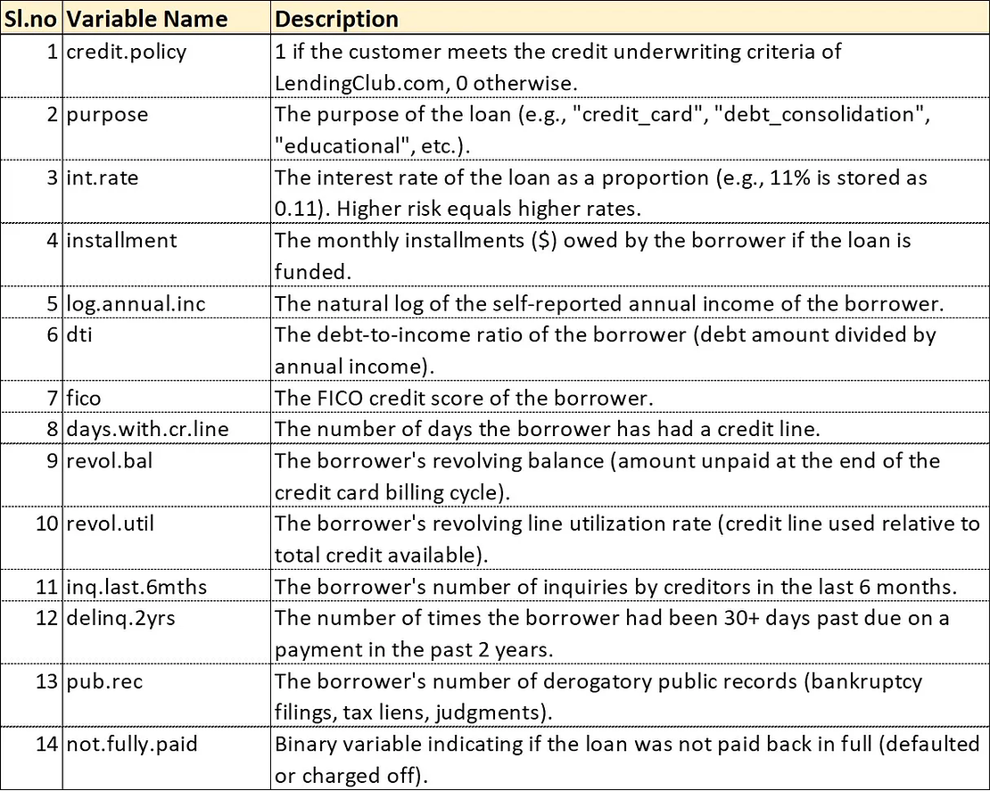
Python Implementation
Credit Risk Analysis for LendingClub.com
You are a data scientist working at LendingClub.com and you have been asked to perform descriptive statistics on the data….

Slide 27
Session Summary
In this session, we have discussed about:
Descriptive statistics help summarize and interpret datasets.
Central tendency measures (Mean, Median, Mode) describe data location.
Dispersion measures (Standard Deviation, Variance, IQR) show variability.

Slide 28
Reference Links
Mastering Credit Risk Analysis: A Step-by-Step Guide to Descriptive Statistics in Python
Top 20 Frequently Asked Questions on Descriptive Statistics for Data Science Aspirants.
How Much Statistics Do You Really Need for Data Science?
Phases of data science and analytics.

